Slide 1
How to Use this Slide Deck
This presentation is for UNICEF staff and other workshop organizers to structure an Out-of-School Children Initiative Policy and Strategy workshop and/or related presentations.
It presents a template for the Policy and strategy workshop described in the OOSCI Operational Manual Section 2.4, and Annex L. It would be held after the Barrier identification workshop.
It can be used for a full training workshop or in part for focused presentations (ex. Policy analysis).
This deck is intended to support OOSCI teams on workshop preparation, especially with respect to the core components of the OOSCI approach. It does not represent a complete presentation, but a useful start for OOSCI workshop organizers.
It is expected that OOSCI teams will modify and add to this template to suit specific regional and country purposes. For example, placeholder slides can be filled with region and country-specific data, relevant timelines, etc.
A blank OOSCI PowerPoint template with slides for additional sections, icons, figures and other designs can be found at www.allinschool.org

Slide 2
Policies and Strategies Workshop
© UNICEF/UN0439619/Dejongh
© UNICEF/UN0439619/DEJONGH
OUT-OF-SCHOOL CHILDREN INITIATIVE

Slide 3
Opening Session
TOPICS COVERED
Setting the scene: Opening remarks from [Name], [Organization]
What do we want to achieve in this workshop?
Meet participants
© UNICEF/UNI96265/MINGFANG
1
Policies and Strategies Workshop
Opening remarks
Workshop objectives and review of agenda
Introduction of participants

Slide 4
Workshop Objectives
Review findings of the Barriers Analysis (Chapter 3);
Discuss findings of the assessment of existing policies and strategies as relates to the major barriers identified for the key profiles of children in the 7DE;
Discuss policy recommendations to overcome the barriers identified, and identify key stakeholders and next steps;
Develop an action plan for the implementation of recommendations; and
Discuss how the findings of the study can be used in future policy discussions and decision-making (dissemination and use).
[Note: Modify as appropriate]
Notes:
7DE: Seven Dimensions of Exclusion

Slide 5
Agenda
TIME | AGENDA ITEM AND PRESENTER | OPERATIONAL MANUAL SECTION
SESSION 1 | OPENING
 | Opening Remarks Meeting Objectives and Review of the agenda Introduction of participants
SESSION 2 | FINDINGS OF THE BARRIERS ANALYSIS
 | Review the findings of the barriers analysis: data consulted, barriers identified, data gaps | Section 3.1 Annex B Section 3.1 Section 3.2 Section 3.2 | Section 5 Annex C, D, E, F
SESSION 3 | REVIEW OF EXISTING POLICIES AND STRATEGIES
 | Overview of existing policy and strategy review: data sources consulted, factors considered Identification of most important policies impacting the barriers and profiles identified in the study | Section 3.1 Section 3.1 Section 4.1 Annex G | Section 6 Annex C, D, E, F
SESSION 4 | CASE STUDIES ON PROMISING POLICIES
 | Experts on various policies (national/international) present example policies and approaches which could address the barriers identified by the study | Section 4.2 Annex H Annex I Section 4.2 | Section 6 Annex C, D, E, F
Session 1: [Title]
Session 2: [Title]
Session 3: [Title]
Session 4: [Title]
Session 5: [Title]
Session 6: [Title]
Session 7: [Title]
SESSION 5 | POLICY AND STRATEGY RECOMMENDATIONS
 | Group Work: Participants will be divided into 5 groups to discuss 5 barriers to access identified in the study and proposed policy recommendations for removing those barriers Plenary presentation of group work | Section 6 Annex C, D, E, F
SESSION 6 | NEXT STEPS – DISSEMINATION AND USE OF STUDY
 | Discuss launch events, key moments where the study can be used to inform decision-making and policy-making Develop national action plan on use and implementation of findings Discuss stakeholders in the study launch and use, how each may be involved, and when | Section 2.5

Slide 6
Participants
[Share your name, organization and connection to children and adolescents out of school and at risk of dropping out]
[Note: Introduce participants, including members of the OOSCI steering committee and technical team (if already established)
This workshop may have more policy-oriented participants in order to facilitate discussion]

Slide 7
Findings of the Barriers Analysis
TOPICS COVERED
What data was consulted in the barrier analysis?
Which barriers were identified?
What are the gaps in the data?
© UNICEF/UNI177582/RICHTER
2
Policies and Strategies Workshop
Review the findings of the barriers analysis: data consulted, barriers identified, data gaps (Section 5, Annexes C, D, E, F)

Slide 8
Summary of the Findings of the Barrier Analysis Chapter
[Note: In this slide, present an overview of the key findings of the barriers chapter, which includes:
Key barriers identified for the profiles of children in the 7DE
Framework used to categorize barriers, with important domains and categories of barriers identified]
[Note: Several slides may be added here to present the results of the analysis]

Slide 9
Findings of the Barrier Analysis
[Example table to be replaced with country OOSCI barriers matrix]
[Note: This slide presents the summary table across the critical barriers, profiles affected, severity (what share of the dimension it represents), magnitude (ranking), and explanatory notes]

Slide 10
Key Barrier: [Insert Here]
[Note: This slide to present the findings in more detail for each of the key barriers identified in the barrier chapter. This includes:
Main data sources used to inform the analysis of this barrier
Profiles affected, with size and severity of impact
Quotes or key findings from the desk review or new data collection
Insight on how this barrier compounds with other barriers to heighten exclusion (or risk of exclusion)
Data gaps or issues].
[Include more barrier slides as appropriate]

Slide 11
Key Barrier: [Insert Here]
[Note: This slide to present the findings in more detail for each of the key barriers identified in the barrier chapter. This includes:
Main data sources used to inform the analysis of this barrier
Profiles affected, with size and severity of impact
Quotes or key findings from the desk review or new data collection
Insight on how this barrier compounds with other barriers to heighten exclusion (or risk of exclusion)
Data gaps or issues].
[Include more barrier slides as appropriate]

Slide 12
Key Barrier: [Insert Here]
[Note: This slide to present the findings in more detail for each of the key barriers identified in the barrier chapter. This includes:
Main data sources used to inform the analysis of this barrier
Profiles affected, with size and severity of impact
Quotes or key findings from the desk review or new data collection
Insight on how this barrier compounds with other barriers to heighten exclusion (or risk of exclusion)
Data gaps or issues].
[Include more barrier slides as appropriate]

Slide 13
Review of Existing Policies and Strategies
TOPICS COVERED
Which data sources and issues have been considered in the analysis?
What are the existing policies and strategies in place?
Which has had the most impact on the barriers and profiles identified in the study?
© UNICEF/UNI210680/BABAJANYAN
3
Policies and Strategies Workshop
Overview of existing policy and strategy review: data sources consulted, factors considered (Section 6)
Identification of most important policies impacting the barriers and profiles identified in the study (Annexes C, D, E, F)

Slide 14
Existing Policy and Programme Review
Guided by the barriers identified in the OOSCI study, a policy analysis critically examines existing policies and programmes
Criteria for review:
Relevance, efficiency, and effectiveness of adopted measures
Beneficiary focus, implementation capacity at the central, sub-national and school levels, Impact
Desk review of key education policies and programmes, as well as relevant laws in other sectors:
Social protection (See Box 6.1), Labour or economic policy (See Annex D), Statistical and civil registry policy (See Annex B), Child protection policy, Health policy (see Annex E), Anti-discrimination policy (see Annex F and Annex E)
More assessment tools are listed in Operational Manual Section 6: Key Resources

Slide 15
Considerations for Policy Analysis
How does the policy interact with the country’s decentralization framework (who is responsible for what, and with what resources)?
Triangulate the desk review of policies with interviews with government and other policy experts, implementing partners, and beneficiaries to better understand the effectiveness of the policy for addressing barriers to school attendance
Consider analyzing policies from other countries (see next section)

Slide 16
Considerations for Prioritizing Policy Recommendations
After the analysis of existing policies is complete, frameworks can be used to develop policy recommendations
MoRES (or alternative frameworks) can be used to categorize policy recommendations into domains (enabling environment, supply, demand and quality) and the categories within each
Operational Manual Section 6.2 (page 105-108) lists potential policy recommendations for consideration
Notes:
MoRES: Monitoring results for equity System

Slide 17
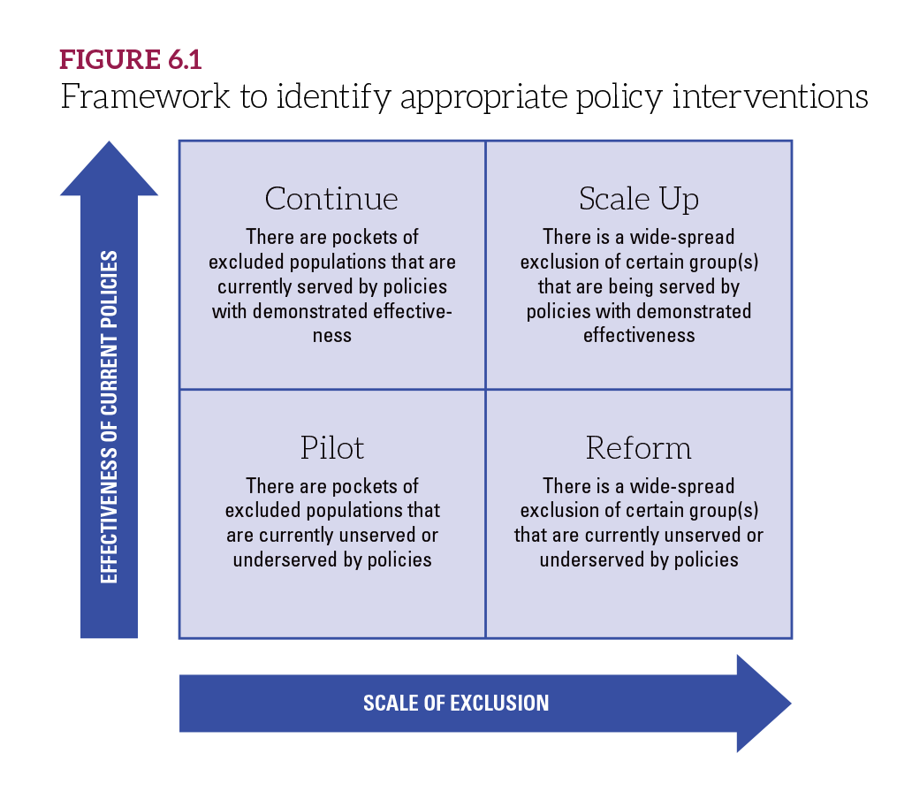
Considerations for Prioritizing Policy Recommendations
Considerations for prioritizing policy recommendations:
Urgency of the issue(s); Existing and potential political commitment from the national leadership; Alignment to the national developmental goals; Cost; Expected impact; and Existing capacities for implementation.
The framework (right) helps analysts frame the appropriate intervention type for promising policies
Guidance for assessing cost-effectiveness and policies for specific groups of children are listed in Operational Manual Section 6: Key Resources

Slide 18
Case Studies on Promising Policies
TOPICS COVERED
Which policies or approaches could be implemented to address barriers to education identified by the study?
What can we learn from [Case Study A]?
© UNICEF/UN0618450/BARUAH
4
Policies and Strategies Workshop
Example policies and approaches which could address the barriers identified by the study (Section 6, Annexes C, D, E, F)

Slide 19
Case Study or Policy Example 1
[Note: This slides are placeholders for the OOSCI technical team, steering committee, or invited policy experts, to make presentations on programmes, policies and/or strategies which may address the issues identified in the analysis. They could relate to any of the MoRES domains or categories. This slide can be replicated to present 2-3 examples to consider.]
Notes:
MoRES: Monitoring results for equity System

Slide 20
Case Study or Policy Example 2
[Note: This slides are placeholders for the OOSCI technical team, steering committee, or invited policy experts, to make presentations on programmes, policies and/or strategies which may address the issues identified in the analysis. They could relate to any of the MoRES domains or categories. This slide can be replicated to present 2-3 examples to consider]

Slide 21
Policy and Strategy Recommendations
TOPICS COVERED
What proposed policy recommendations could remove those barriers?
© UNICEF/UNI93409\SIBONELO KHUMALO
5
Policies and Strategies Workshop
Discussion of the barriers to access identified in the study and proposed policy recommendations for removing those barriers (Section 6)
Plenary Presentation of group work (Annexes C, D, E, F)

Slide 22
Policies Impacting Barriers and Profiles
This table presents the linkages between all three stages of the OOSCI analysis: profiles, barriers and policies and strategies.
[Note: After the policy analysis and prioritization, this slide could present the example from the Operational Manual, below, or present some initial findings for the country/region].

Slide 23
Group Activity on Policy Recommendations
Groups could also be organized around key policies that affect the barriers identified
After having discussed the key barriers to education, possible policy areas and considerations, the technical team and steering committee can now identify some of the key policies to be investigated in the analysis:
Activity: Break into [#] groups (one for each key barrier) to discuss:
What are the key policies impacting this barrier? What kinds of effects do they have (intended and unintended) on the targeted beneficiaries?
What parts of the policy are effective, what parts are not effective? Why?
[Note: Add/Modify questions as suitable to the country/workshop design]
Notes:
Guidance questions for discussion of a specific policy:
Who are the main intended beneficiaries of the policy?
What kind of barriers have been identified and addressed in the policy?
Does the policy include efforts to address social and behavioural barriers to enable inclusive education?
What are the achievements of the policy? Was there any unintended effect of the policy?
How was the progress monitored?
Were the interventions relevant to address the barriers?
To what extent the representatives of the targeted beneficiaries were involved in the design, monitoring, and implementation of the policy?
What was the cost associated with the policy implementation? Was the policy adequately funded?
Was there enough capacity for the policy implementation?
To what extent was a shared understanding of the policy developed by designers and by those education actors at the sub-national level who are tasked to implement it?

Slide 24
Plenary Presentation of Group Work
After the group discussions, each group can report highlights back to the plenary. Then, as a plenary, the discussion can shift to looking across the policies and prioritization:
What are the most commonly mentioned policies across the barriers?
Are there policies that significantly affect one profile or barrier in particular?
Which domains, or categories in the MoRES (or alternative) framework comes up the most often when mentioning policies?
Should the policies analysis in the OOSCI include interviews and focus groups? With whom and on what topics? When?
Notes:
18th International Conference of Labour Statisticians (ICLS) in 2008

Slide 25
Next Steps: The Dissemination And Use Of the Study
TOPICS COVERED
What are the key moments where the study can be used to inform decision-making and policy-making?
How can we develop a national action plan to use and implement the findings?
How and when can we involve stakeholders in the study launch?
© UNICEF/UNI86201/RAMONEDA
6
Policies and Strategies Workshop
Discuss launch events, key moments to inform decision-making and policy-making
Develop national action plan on use and implementation of findings (Section 2.5)
Discuss stakeholders and how each may be involved, and when (Section 2.5)

Slide 26
Planning for Impact: Launch Events and Key Entry Points
In the OOSCI study process launch workshop, we identified the following:
The main purpose of the OOSCI study: [Note: this could be increase advocacy on the issues; updated estimates of OOSC/dropout; improve data collection methods; analysis of particular profiles of children; evaluate specific policy/programme]
Key stakeholders for policy use and dissemination: [Note: Insert agreed stakeholders, interests and roles here]
Entry points for use of OOSCI study findings: [Note: Insert entry points here]
Plenary discussion: Are there any additions or updates to the purpose, stakeholders or entry points for the OOSCI study, as we near the official launch date?
Entry points:
Specific government, partner or NGO programmes related to OOSC or dropout;
Upcoming policy windows – such as the Education Strategic Plan, or similar;
Upcoming revisions to education data systems – EMIS, household survey;
Events or meetings – such as annual ministry research meetings]

Slide 27
Developing a National Action Plan
National Action Plan: A working document that outlines how the OOSCI study findings will contribute to existing national policy and programming processes with government, NGOs and development partners. It moves the study to action. It could include:
Planned updates of analysis or filling of gaps
Costing plan for priority policy implementation
Technical assistance plans to respond to capacity gaps identified in study
Inter-sectoral coordination mechanisms
Communication strategy: To maximize study impact, identify objectives, target audiences and stakeholders for key messages and media
[Note: OOSCI Social media templates (Twitter, Instagram, Facebook, LinkedIn) are available for OOSCI teams on allinschool.org]
See Operational Manual Section 2.5 for more details.

Slide 28
Next Steps for the Development of the Policies and Strategies Chapter
Technical team members involved in policies and strategies chapter: [Note: List, with leads on policy desk review, policy analysis, triangulating interviews, review of draft chapter]
Timeline for chapter drafting: [Note: Add key deadlines here]
Role for Steering Committee members: [Note: Add key roles here – may include key informant interviews on policies; review of draft chapter]
[Note: Several slides may be added here to discuss the next steps for the policies chapter]

Slide 29
Next Steps on Dissemination and Use
Identification of entry points for use of OOSCI study findings: [Note: add dates here; responsible team]
Proposed date for the Launch workshop: [Note: add dates here]
Finalization of communication strategy: [Note: add dates here; responsible team]
Drafting of national plan: [Note: add dates here; responsible team]

Slide 30
Thank You
CONTACT
First Last Name
Role or Title Here
Name of Department
email@address.org
© UNICEF/UN0518460/BIDEL
ALLINSCHOOL.ORG
Question and Answer Session

