Slide 1
How to Use This Slide Deck
This presentation is for UNICEF staff and other workshop organizers to structure an Out-of-School Children Initiative Barrier Identification workshop and related presentations.
It follows the “Barrier identification workshop" agenda and structure that are described in the OOSCI Operational Manual Annex L, Page 164. This workshop would follow the Launch and Data and Profiles workshops.
It can be used for a full workshop, or be used in part for focused presentations (for example a session to brainstorm barriers).
This deck is intended to support OOSCI teams in workshop preparation, especially with respect to the core components of the OOSCI approach. It does not represent a complete presentation, but a useful start for OOSCI workshop organizers.
It is expected that OOSCI teams will modify and add to this template to suit specific regional and country purposes. For example, placeholder slides can be filled with region and country-specific data, relevant timelines, etc.
A blank OOSCI PowerPoint template with slides for additional sections, icons, figures and other designs can be found at www.allinschool.org

Slide 2
Barrier Identification Workshop
© UNICEF/UN0439619/Dejongh
© UNICEF/UN0439619/Dejongh
OUT-OF-SCHOOL CHILDREN INITIATIVE

Slide 3
Opening session
TOPICS COVERED
Setting the scene: Opening remarks from [Name], [Organization]
What do we want to achieve in this workshop?
Meet participants
© UNICEF/UNI96265/MINGFANG
1
Barrier Identification Workshop
Opening remarks
Workshop objectives and review of agenda
Introduction of participants

Slide 4
Workshop Objectives
Review findings of the OOSCI Study draft chapters 1 and 2 (7DE numbers, rates, and profiles);
Agree on most important profiles to focus on in the barriers analysis (Chapter 3);
Identify likely barriers faced by these profiles, using the MoRES (or comparable) framework;
Identify key data sources for the barriers analysis and address possible data gaps; and
Agree on next steps.
[Note: Modify as appropriate]
Notes:
OOSCI: Global Out-of-school Children Initiative
7DE: Seven Dimensions of Exclusion
MoRES: Monitoring Results for Equity System

Slide 5
Agenda
TIME | AGENDA ITEM AND PRESENTER | RELEVANT SECTION IN OPERATIONAL MANUAL
SESSION 1 | OPENING
 | Opening Remarks Meeting Objectives and Review of the agenda Introduction of participants
SESSION 2 | REVIEW OF ESTIMATIONS OF NUMBER OF CHILDREN IN 7DE (DRAFT CHAPTER 1)
 | Data sources used for the calculation of number and share of children in the 7DE Data gaps and issues identified in the data inventory and quality assessment Estimates of children, adolescents and youth in the 7DE | Section 3.1 Section 3.1 Section 3.2 Annex B
SESSION 3 | PROFILES OF CHILDREN IN THE 7DE
 | Findings from draft Chapter 2 (Profiles) Profiles of children identified Profile 1 Profile 2 Profile 3 Discussion on key profiles for OOSCI study | Section 4.1, 4.2, 4.3, Annexes G, H, I Section 4.4 Annexes C, D, E, F
SESSION 4 | INTRODUCTION TO BARRIERS ANALYSIS
 | Overview of barriers analysis, introduction of MoRES framework categories (or alternative framework, if using) and barriers examples Identification of data sources and key stakeholders with information on barriers to education faced by the agreed profiles | Section 5.1 Section 5.2
SESSION 5 | IDENTIFYING KEY BARRIERS FACED BY THE PROFILES OF CHILDREN IN THE 7DE
 | Group Work: Participants will be divided into 5 groups to discuss 5 profiles of children in the 7DE and the barriers which may exclude them from education, and categorize barriers according to the MoRES (or alternative) framework dimensions Plenary presentation of group work Discuss data gaps and possible plans for primary data collection (during or after study) to address them | Section 2.2 Annexes C, D, E, F
SESSION 6 | FROM BARRIERS TO POLICIES
 | Discuss most important barriers and develop the barriers matrix: both those that impact multiple profiles of out-of-school children , or those which significantly impact a single profile Agree on next steps for the development of the policy and strategies chapter, planning for study dissemination and use | Section 4.4 Section 2.5
Session 1: [Title]
Session 2: [Title]
Session 3: [Title]
Session 4: [Title]
Session 5: [Title]
Session 6: [Title]

Slide 6
Participants
[Share your name, organization and connection to children and adolescents out of school and at risk of dropping out]
[Note: Introduce participants, including members of the OOSCI steering committee and technical team
This workshop may have more representatives and members of the groups identified as key profiles of children in the 7DE in order to enhance discussion of barriers to education]

Slide 7
Estimation of Children in the 7DE
TOPICS COVERED
What sources of data were used for the calculation of number and share of children in the 7DE?
What are the issues and gaps in data that have been identified?
What are the estimates of children, adolescents and youth in the 7DE?
© UNICEF/UNI177582/RICHTER
2
Barrier Identification Workshop
Data sources in the 7DE Overview (Section 3.1)
Issues identified in the data inventory and quality assessment (Section 3.1)
Estimates of children in the 7DE (Section 3.2 + Annex B)
Notes:
[Note: This section presents the main findings of the Data Chapter 2, in order to guide the following discussions on barriers to education]

Slide 8
Data Sources for Profiles of Children in the 7DE
Main data sources utilized to calculate the 7DE estimates:
Administrative data:
Reasons for selection:
Gaps and issues identified:
Household survey(s):
Reasons for selection:
Gaps and issues identified:
[Note: The reasons for selection, gaps, and issues identified draw on the data inventory and quality assessment tool, challenges discussed at the previous data workshop, and issues raised during the calculation by the technical team].

Slide 9
Out-of-school Children, Adolescents and Youth in [Country], DE 1,2,3,6
[Note: Placeholder for key findings related to the number and share of out-of-school children].
[Example table to be replaced]
Notes:
[Note: Insert table or figure here with the number and share of children in the Dimensions 1,2,3 and 6, from the 7DE tool or otherwise].

Slide 10
Children at Risk of Dropping Out in [Country], (DE4,5,7)
[Note: Placeholder for key findings related to the number and share of children at risk of dropping out].
[Example table to be replaced]

Slide 11
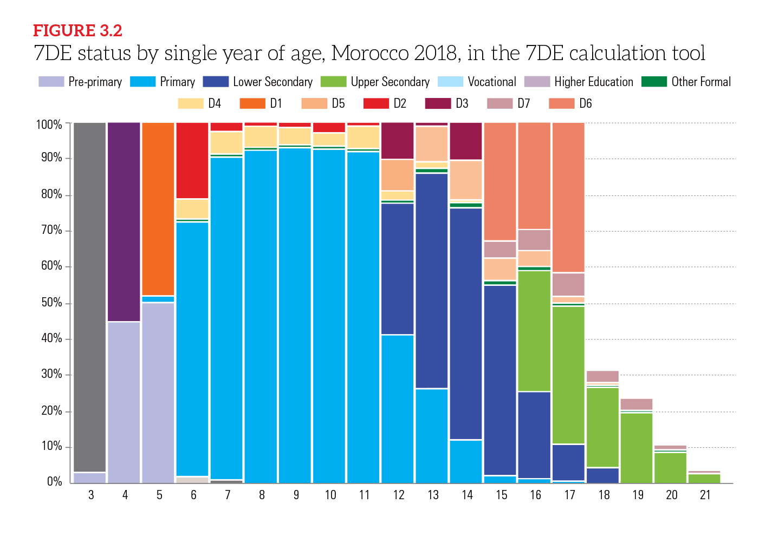
Estimates of Children, Adolescents and Youth in the 7DE
Dimensions with the highest overall number (scale of exclusion): [add here]
Dimensions with the highest percentage (severity of exclusion): [add here]
[For example, in the Morocco example, Dimension 6 has the highest number (upper secondary age youth out of school), but the dimension with the highest rate of exclusion is Dimension 1]
[Example figure to be replaced]
Notes:
[Note: Insert figure here with the relevant visualization of the share of children enrolled in school (by age and level) and in the 7DE, from the 7DE tool or otherwise].

Slide 12
Trends Over Time / Other Estimates of Out-of-School Children
[Note: Placeholder for a figure to present the new estimates of DE1, 2, 3, and 6 in a time series – to discuss whether the number and share of out-of-school children is increasing, staying the same, or decreasing]
[Note: This slide can also be used to discuss these estimates in reference to other common estimates [explaining discrepancies] or reference studies known to stakeholders on the number of children out of school].

Slide 13
Profiles of the Children in the 7DE
TOPICS COVERED
What are the findings from draft Chapter 2?
What are the key profiles of children we have identified?
© UNICEF/UNI210680/Babajanyan
3
Barrier Identification Workshop
Findings from draft Chapter 2 (Section 4.1, 4.2, 4.3)
Profiles of Children Identified (Annexes G, H, I)
Discussion on Key Profiles for OOSCI study (Annexes C, D, E, F)

Slide 14
Summary of Findings from Draft Profiles Chapter
[Note: In this slide, present an overview of the key findings of the profiles chapter, which includes:
Key profiles identified
School exposure of out-of-school children
Flows in and out of the system (Exclusion points in system)
Pathway analysis or cumulative risk analysis visualizations]
[Note: Several slides may be added here to present the results of the analysis]

Slide 15
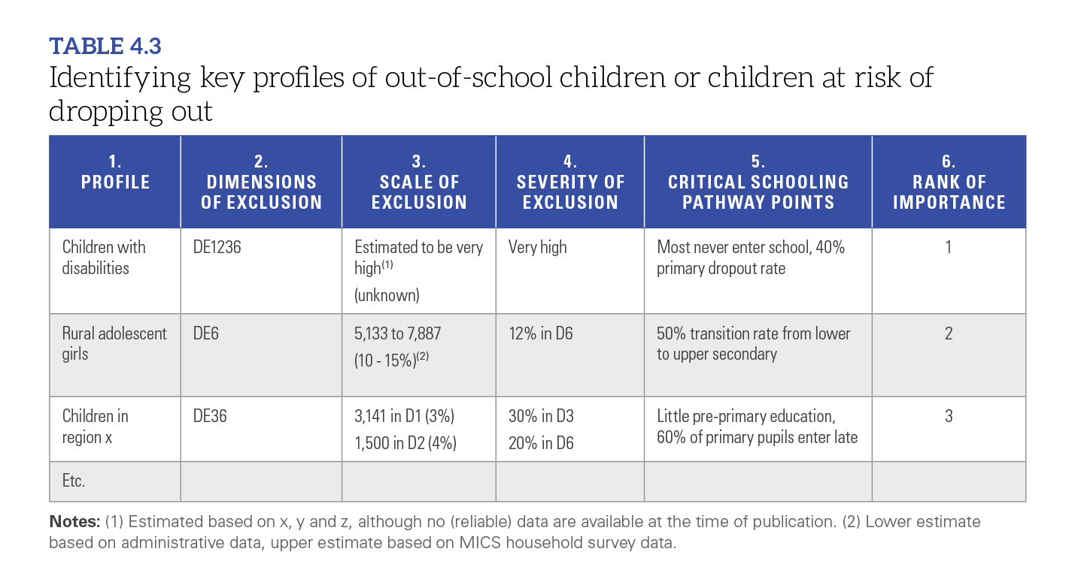
Profiles Matrix
[Note: This slide presents the summary table across the main profiles, dimensions of exclusion affected, scale (number and share), severity (what share of the dimension it represents), when along the schooling pathway this profile is excluded, and a provisional ranking of importance to the study]
[Example table to be replaced]

Slide 16
Key Profile: [Insert Here]
Some important profiles of out-of-school children or 7DE may not have high-quality and recent data – but they can still be identified in the study for Barriers and Policy analysis.
Qualitative data or new data collection can shed light on these vulnerable groups.
[Note: This slide to present the findings in more detail for each of the key profiles identified in the data and profiles chapters. This includes:
Main data sources where they are identified
Data gaps or issues
Size and share of exclusion, when it is likely to occur
Insight from cumulative risk analysis – Ex. Rural adolescent girls -- impact of each characteristic that is linked to school exclusion].

Slide 17
Key Profile: [Insert Here]
[Note: This slide to present the findings in more detail for each of the key profiles identified in the data and profiles chapters. This includes:
Main data sources where they are identified
Data gaps or issues
Size and share of exclusion, when it is likely to occur
Insight from cumulative risk analysis – Ex. Rural adolescent girls -- impact of each characteristic that is linked to school exclusion].
[Include more profile slides as appropriate]

Slide 18
Key Profile: [Insert Here]
[Note: This slide to present the findings in more detail for each of the key profiles identified in the data and profiles chapters. This includes:
Main data sources where they are identified
Data gaps or issues
Size and share of exclusion, when it is likely to occur
Insight from cumulative risk analysis – Ex. Rural adolescent girls -- impact of each characteristic that is linked to school exclusion].
[Include more profile slides as appropriate]

Slide 19
Discussion: Key Profiles
After having reviewed the 7DE estimates and profiles of children in the 7DE identified in the draft analysis, the technical team and steering committee can agree on the priority profiles and issues for the barriers analysis.
Plenary discussion:
What are the key profiles of children the OOSCI study should focus on for the identification of barriers to education?
Are there key exclusion points in the system which merit emphasis in the barriers analysis?
[Note: Add/Modify questions as suitable to the country/workshop design]
Notes:
Note: See Annex B for a deeper discussion of the visibility model, and Table 1.2 for a comparison of the visibility model with the 7DE model.

Slide 20
Introduction to Barriers Analysis
TOPICS COVERED
What are barriers to education, and how do they fit into the MoRES framework?
What are the data sources and key stakeholders with information on barriers to education faced by each of our profiles?
© UNICEF/UN0618450/BARUAH
4
Barrier Identification Workshop
Overview of Barriers Analysis (Section 5.1)
Introduction of MoRES framework and barriers examples (Section 5.1)
Identification of Data Sources and Key Stakeholders (Section 5.2)

Slide 21
Overview of Barriers Analysis
Barriers: Factors that contribute to school exclusion that can be changed. The reasons or “why” of school exclusion.
Push: exclusionary factors originate within the schooling system (ex. school expulsion; stigma by school staff)
Pull: factors outside school that lead to dropout (Ex. family responsibilities)
Common barriers across 19 OOSCI studies:
Cost and financing; Absence of tailored services; Access (supply); Violence; Child labour; Cultural norms; Education policy; Teacher issues
See Table 5.1 in the Operational Manual for the full list
Operational Manual annexes discuss barriers specific to:
Out-of-school children in emergencies (Annex C), children in child labor (Annex D), children with disabilities (Annex E), and children in ethnolinguistic groups (Annex F)

Slide 22
Barriers Analysis Frameworks: MoRES
MoRES: Monitoring Results for Equity System (UNICEF)
A conceptual framework to organize the barriers to school into useful categories for policy action
Four major domains:
Enabling environment: Social norms, policy/legal framework, budget/expenditure, institutional management/coordination.
Supply: Availability of essential inputs, and adequately staffed services, facilities, and information
Demand: Financial access, social and cultural practices, and beliefs, continuity of use
Quality of services and goods.

Slide 23
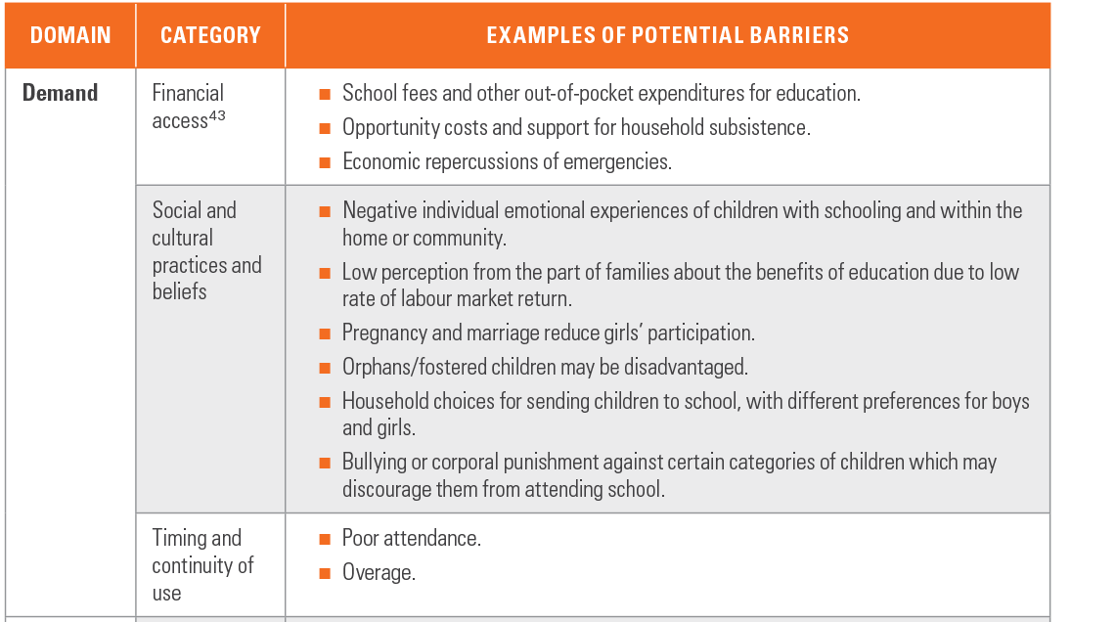
MoRES Framework : Examples of Potential Barriers by Domain and Category
This table shows example barriers to schooling that apply to the domain of demand
Financial access
Social and cultural practices and beliefs
Timing and continuity of use
The full table of example barriers is presented in Table 5.4 on page 94 in the Operational Manual.

Slide 24
Barrier Analysis Frameworks: Disability-Inclusive Education
The OOSCI study barrier analysis could adopt other related frameworks to organize the findings
The Framework for Disability-Inclusive Education has similar domains but different categories within them, which are more specific to the education sector.
Other alternative frameworks include SABER and the Behavioural Drivers Model (See Section 5.2.2 (page 92) in the Operational Manual.
Source: Education Sector Analysis (ESA) Methodological Guidelines, Volume 3
Notes:
SABER: Systems Approach for Better Education Results

Slide 25
Data Sources for Barriers & Policy Analysis
Three main sources of data: Literature review; existing quantitative data and reports; primary data collection (See Table 5.2 in the Operational Manual)
1) Desk review (literature review) examines relevant academic, policy and ‘grey’ literature on the profiles of interest for information on factors that lead to school exclusion (or factors that promote school retention and success)
2) Quantitative data can also be used to build a more holistic picture of the profile to identify factors of exclusion. For example: student performance on national and standardized tests, smaller scale data collections, EMIS data on teacher allocation, training and school resources…
Reports, articles and data vary in quality and suitability for an OOSCI study – see resources under “Research Methods and Issues” on page 100 of the Operational Manual

Slide 26
Data Sources for Barriers & Policy Analysis
3) Primary data collection: Where existing data is limited, the OOSCI study can collect new quantitative (ex. survey) or qualitative data (ex. interviews, focus groups) from students, teachers, parents, agencies representing vulnerable groups, or other experts
Data collection with vulnerable groups (ex. children, marginalized communities) should follow the ethical guidelines in UNICEF 2021 procedure.
Involving adolescents in data collection can be valuable exercise, including leading focus group discussions, or using life histories, visual, play, arts and computer-based approaches. Important to follow safeguarding and ethical guidelines (see resources under “Research Methods and Issues” on page 100 of the Operational Manual)
Notes:
UNICEF. 2021. ‘UNICEF Procedure on Ethical Standards in Research, Evaluation, Data Collection and Analysis.’ PROCEDURE/OOR/2021/001. New York: UNICEF. https://www.unicef.org/ evaluation/media/1786/file/UNICEF%20 Procedure%20on%20Ethical%20 Standards%20in%20Research,%20 Evaluation,%20Data%20Collection%20 and%20Analysis.pdf.
Important considerations

Slide 27
Identifying Key Data Sources and Stakeholders
After having reviewed the key frameworks and data source categories for the analysis of barriers to education, the technical team and steering committee can agree on the key data sources and stakeholders to be included:
Plenary discussion:
What are some key literature, reports or studies which should be included in the desk review on barriers to education?
Are there key quantitative data sources that should be included to get a richer picture of the barriers (and enabling factors) for specific profiles of children in the 7DE?
Which organizations, stakeholders or experts should be consulted as part of the barriers research?
[Note: Add/Modify questions as suitable to the country/workshop design]

Slide 28
Identifying Key Barriers Faced by Profiles in the 7DE
TOPICS COVERED
How can the profiles and barriers analysis be linked together?
What are some of the key barriers the study should investigate?
Are there any gaps in data around these barriers?
What possible plans for primary data collection can be implemented to address these barriers?
© UNICEF/UNI93409\Sibonelo Khumalo
5
Barrier Identification Workshop
Tables to highlight the critical barriers to education and the barriers matrix (Section 5.3 and 5.4)
Plenary discussion of data gaps and possible plans for primary data collection to address them (Annexes C,D,E,F)

Slide 29
Linking the Profiles of Children in the 7DE to Barriers to Education
The barriers analysis should identify the critical barriers for each profile and the relevant domain and category within the MoRES (or alternative framework)
This table provides an example of how the study could systematically link the profiles to the barriers analysis
See Section 5.3 in the Operational Manual for more information

Slide 30
Determining Critical Barriers
The analysis can be ‘flipped’ by identifying the most common, and critical, barriers to education which affect multiple profiles of children.
This table provides an example of how the study could identify the most pressing barriers to education, toward prioritization for policy analysis
Of course, out-of-school children face multiple, compounding barriers to education, which will be important to capture in the narrative of Chapter 3.

Slide 31
Group Activity on Barriers to Education
After having discussed the key profiles of children in the 7DE, the common barriers to education, and key stakeholders, the technical team and steering committee can now identify some of the key barriers to be investigated in the analysis:
Activity: Break into [#] groups (one for each key profile) to discuss:
What are the barriers to education this group of children face?
What barriers are linked to the enabling environment, supply, demand and quality? Push and pull factors?
What are the most important barriers for this profile?
What are the possible exclusionary factors for which insufficient information is available?
[Note: Add/Modify questions as suitable to the country/workshop design]

Slide 32
Plenary Discussion on Barriers
After the group discussions, each group can report highlights back to the plenary. Then, as a plenary, the discussion can shift to looking across the profiles and prioritization:
What are the most commonly mentioned barriers to education across the profiles?
Are there barriers that significantly affect one profile in particular?
Which domains, or categories in the MoRES (or alternative) framework come up the most often when mentioning barriers?
Should the barriers analysis in the OOSCI include new data collection? What kind and with whom? When?

Slide 33
From Barriers to Policy
TOPICS COVERED
What are our next steps for developing a chapter on policy and strategies?
© UNICEF/UNI86201/RAMONEDA
6
Barrier Identification Workshop
Next steps for developing a chapter on policy and strategies (Section 2.5)

Slide 34
Next Steps for the Development of the Barriers Chapter
Technical team members involved in barrier identification chapter: [Note: List, with leads on desk review, complementary quantitative data, stakeholder interviews, new data collection, review of draft chapter]
Timeline for chapter drafting: [Note: Add key deadlines here]
Role for Steering Committee members: [Note: Add key roles here – may include key informant interviews on barriers; review of draft chapter]
Proposed date for the policy and strategy workshop: [Note: add dates here]
[Note: Several slides may be added here to discuss the next steps for the barriers chapter]

Slide 35
Thank You
CONTACT
First Last Name
Role or Title Here
Name of Department
email@address.org
© UNICEF/UN0518460/Bidel
ALLINSCHOOL.ORG

